Slide 1
Physics 1 – Oct 17, 2019
P3 Warmup –
Two masses are connected by a cord and pulled to the right by another cord. (Assume frictionless surface.)
Draw free body diagrams for a) green mass, b) red mass, c) the two blocks together
Then complete a District Qtr 1 Assessment by yourself with a calculator. (approx. 15-20 min)
Today’s Objective: Second Law Problem Solving (frictionless)
Get out Forces homework for check
T
F

Slide 2
Agenda, Assignment
IB 2.2 Forces
Second Law Problems (frictionless)
Agenda
District Qtr1 Assessment activity
Homework review
Kinematics and the second law
General Second Law Problem solving
Sample problem
Practice
Assignment:
Second Law Problems Worksheet

Slide 3
Typical Second Law Problem Solving
1) Draw the system. Label with masses and Forces and any other data.
2) Choose the body of interest (to be treated as a point mass) and a frame of reference.
3) Draw the Free Body Diagram, including all forces acting on the body of interest. Include the direction for each.
4) Resolve all forces at an angle into their x and y components.
5) Write the expression for the net force in each dimension (F_{net,x} = Right – left, F_{nety} = Up – down)
6) Write the second law equation for each dimension F_{net,x} = ma_{x} F_{nety} = ma_{y}
7) (Opt first or last step) Connect to kinematics through acceleration.

Slide 4
Sample 2nd Law Problem
A 21 kg child on a 16 kg sled is being dragged over “frictionless” snow by a rope that makes a 30° angle to the horizontal. What is the tension in the rope when the sled is taken from rest to a speed of 1.3 m/s in 3.5 seconds?

Slide 5
Sample 2nd Law Problem
Four penguins are being playfully pulled along very slippery (frictionless ice) by a curator. The masses of three of the penguins and two of the tensions are known. m₁ = 12 kg, m₃ = 15 kg, m₄ = 20 kg, T₂ = 111 N and T₄ = 222 N. Determine the mass of the fourth penguin m₂, the acceleration of the penguins, a, and the two missing tensions. T₁ and T₃.

Slide 6
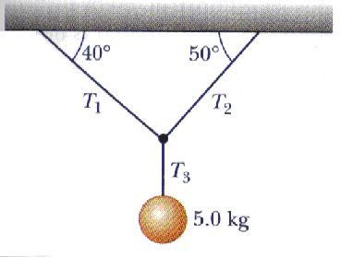
Sample 2nd Law Problem
Determine the three tensions.

Slide 7
Exit Slip - Assignment
How do you write the second law equation in the x dimension? In the y dimension?
What’s Due on Nov 2? (Pending assignments to complete.)
Complete the 2nd law worksheet
What’s Next? (How to prepare for the next day)
Read p57-75

